Slide 1
Object Oriented Data Structures
Stacks
Stack Specifications
Implementations of Stacks
Abstract Data Types and Their Implementations

Slide 2
Authors' Code
The authors have included sample code for the development of many data structures. For their code they have developed a utility package that is explained on page 678
The code in the book does not always represent the most efficient way that might be used but represents different ways of approaching the subject.

Slide 3
Type
A type is a set, and the elements of the set are called the values of the type.
Example: int is a type. Means the set of all integers.
When we use type int in certain language for certain machine, it means a limited number of integers.
Note the distinction between abstract type and its implementation.

Slide 4
A type is:
Atomic: its values are single entities. They are not intended to be divided. Ex: int, char.
Structured: its values are structures. Ex: arrays, classes, pointers which are used to build structures.
A value of a structured type has two ingredients: component and structure.

Slide 5
There are mathematical rules for building structured types: set, sequence, and function.
To study lists of various kinds, we need the finite sequence.
Definition of sequence:
  A sequence of length 0 is empty.
  A sequence of length n >=1 of elements from a set T is an ordered pair (Sn-1 ,t) where Sn-1 is a sequence of length n-1 of elements from T, and t is an element of T.

Slide 6
Abstract Data Type (ADT)
Description of the way in which the components are related to each other
Statement of the operations that can be performed on elements of the ADT

Slide 7
Abstract Data Type
DEFINITION: A stack of elements of type T is a finite sequence of elements of T , together with the following operations:
1. Create, creates the stack, leaving it empty.
2. Empty tests whether the stack is empty or not.
3. Push, pushes a new entry onto the top of the stack, provided the stack is not full.
4. Pop, removes the entry off the top of the stack, provided the stack is not empty.
5. Retrieve, gets the top entry from the stack, provided the stack is not empty.
Note: Nothing is mentioned about the stack implementation.
This is called an Abstract Data Type.

Slide 8
Implementations in the Text
Use of upper case for names
Use of typedef statements for data types
Syntax: typedef char Stack_entry;
Error processing
  Enumerated type for errors
  Success, overflow, underflow
  User decides how to handle error
  Syntax: enum Error_code {success, overflow, underflow};
No preconditions

Slide 9
Standard Template Library
Copyright @ 1996
Silicon Graphics Computer Systems, Inc.
The Standard Template Library, or STL, is a C++ library of
container classes, algorithms, and iterators; it provides many of the basic algorithms and data structures of computer science.
The STL is a generic library, meaning that its components are heavily parameterized: almost every component in the STL is a template. You should make sure that you
understand how templates work in C++ before you use the STL.
--STL Help Files

Slide 10
Template
Template<class T> template<class T>
Class Stack { Stack<T>::Stack(int s)
public: {
Stack(int = 10); size = s > 0 ? s : 10
bool push(const T &); top = -1;
bool top (T &); stackptr = new T[size];
private: }
int size;
int top;
T *stackptr;
}
In the main we have: Stack<double> doubleStack(5);

Slide 11
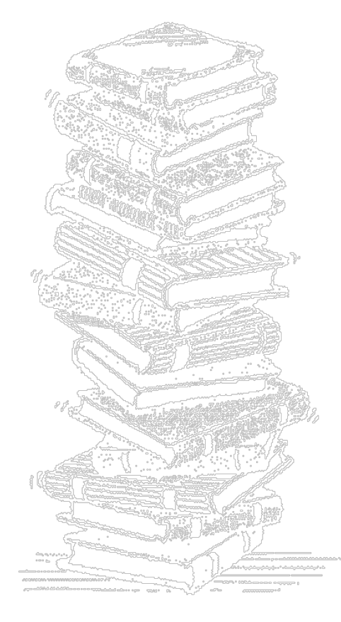
Stacks
Run-time stacks
Stacks of pancakes
Stacks of plates
Stacks for reversal
Stacks for sorting

Slide 12
Basic Idea
A stack can hold an arbitrary number of elements, but you place new elements and remove elements only from the top.
Sometimes called a LIFO structure, for Last In, First Out.

Slide 13
ADT - Stack
Create the stack, leaving it empty
Test whether the stack is empty
Push a new entry onto the top of the stack, if possible
Pop the entry off the top of the stack, if not empty
Retrieve top element of stack, if not empty
A stack of elements of type T is a finite sequence of elements of T, together with the operations:

Slide 14
Generalized Concepts
An array is a static data structure because its size is fixed.
A list is a dynamic data structure because its size can change.
A stack can be implemented statically using array (vector) or dynamically using linked list.

Slide 15
Example: (STL) Reversing a List
#include <stack>;
#include <iostream>
using namespace std;
int main()
{
int numberInStack;
double item;
stack<double>numbers;
cout <<“enter an integer n and n numbers;
cin >> numberInStack;
for (int i=0; i<numberInStack; i++){
cin >> item;
numbers.push(item); }
while(!numbers.empty()){
cout<<numbers.top()<<"";
numbers.pop(); }
}

Slide 16
Entry Types, Generics
typedef char Stack_entry
The previous example used stacks from the Standard Template Library (STL). Use of templates allowed the developers of the STL to defer specifying the type of object to be stored in the stack until the stack was used (instantiated).
The authors are going to want code that is generic but they chose to postpone writing templates until chapter 6. To achieve a level of generic code they start by using typedef declarations.

Slide 17
Contiguous (array)
Implementation from Text
Enum ErrorCode{success, overflow, underflow};
typedef char StackEntry;
const int MAXSTACK = 10;
class Stack
{
public:
Stack();
bool empty() const;
ErrorCode pop();
ErrorCode top(StackEntry & item) const;
ErrorCode push(const StackEntry & item);
private:
int count;
StackEntry entry[MAXSTACK];
} //end Stack

Slide 18
Constructor
Stack::Stack()
{
// Pre: None
// Post: Stack initialized to empty
count = 0;
} //end Stack()

Slide 19
push() - add something to Stack
ErrorCode Stack::push(const StackEntry &item)
{
// Pre: None
// Post: If not full, item added to top
// If full, overflow returned, stack same
ErrorCode outcome = success;
if(count >= MAXSTACK)
outcome = overflow;
else
entry[count++] = item;
return outcome;
}//end push()

Slide 20
pop() - remove top item
ErrorCode Stack::pop()
{
// Pre: None
// Post: If not empty, item removed
// If empty, underflow returned
ErrorCode outcome = success;
if(count == 0)
outcome = underflow;
else
--count;
return outcome;
}//end pop()

Slide 21
top() - return top item
ErrorCode Stack::top(StackEntry & item)const
{
// Pre: None
// Post: If not empty, top item returned
// If empty, underflow returned
ErrorCode outcome = success;
if(count == 0)
outcome = underflow;
else
item = entry[count - 1];
return outcome;
}//end top()

Slide 22
empty() - test condition
bool Stack::empty()const
{
// Pre: None
// Post: returns true or false
bool outcome = true;
if(count > 0)
outcome = false;
return outcome;
}//end empty()

Slide 23
Application of Stack
1. Reversing Items
  Numbers
  Train Cars
2. Bracket Matching
3. Reverse Polish Calculator
4. Function Call and Recursion
5. Depth First Graph Traversal

Slide 24
Refinement of Data Specification
Abstract Data Type is a general definition.
We need to refine this general definition to help designing the program.
There is a close analogy between top-down refinement of Algorithms and Data Structures.
We start with a general definition and end up with program code.
The number of stages varies from problem to problem.

Slide 25
Refinement of Data Specification
The refinement will be done at four levels:
Abstract Level
  Decide relationship between elements and operations needed
Data Structures Level
  Specify sufficient details to make choices dictated by problem
Implementation Level
  Decide details of computer memory representation
Application Level
  Programming details for particular application

Slide 26

Chapter 2 Sets in the West

Slide 27
Refinement of Data Specification
Abstract Level
  Decide relationship between elements and operations needed
Data Structures Level
  Specify sufficient details to make choices dictated by problem
Implementation Level
  Decide details of computer memory representation
Application Level
  Programming details for particular application
conceptual
algorithmic
programming

